Slide 1

Successful FOTS bids
2016 onwards

Slide 2

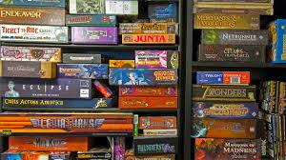

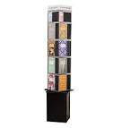

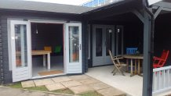
Since February 2016…
FOTS has given £95,000+ to:
Pastoral support:
Thornden Young Carers, Bereavement Group, Pastoral Care, The Hub, Mental Health Champions Scheme, additional support for Pupil Premium students, Forest School, Learning support
Built Environment:
Library resources, History wall art, Library mural, Water fountains, Picnic tables and benches, Cycle club storage container, Y7 Courtyard enhancement, The Shed projects

Slide 3
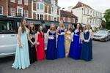


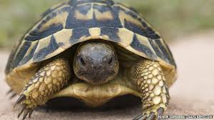
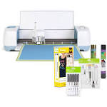
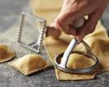

£91,000+ since February 2016…
Clubs and Activities:
Go kart club, Warhammer/D&D, Stem club, Textiles club, Art Club, Creative Writing, Green Team, Sports clubs, Maths games, Lego, MFL spelling bee prizes, Cycle repair, Y7 classroom games and library, Duke of Edinburgh, Prom, leavers` event
Curriculum enrichment:
Maths Games, Author visits, Sports Team kit, Science ducklings and tortoise, History text books, Geography equipment, Food tech pasta makers, costume support for Drama and Dance, additional technical equipment such as laptops, goose necked cameras, graphics tablets etc.

Slide 4
2014-2015 (pre donation scheme)
£750

Slide 5
2015-2016
£4636

Slide 6



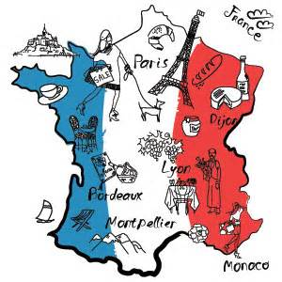
Where the money has gone…
2015/16
What a difference a year makes!
Last year 2014/2015 - £750 (Thornden Young Carers)
This year £4636 given to the School including:
Thornden Young Carers group (£1000 this academic year)
The Shed Project - furnishing and finishing (£1000)
Go-kart club £150
Team netball kit £150
An Italian 'batterie de cuisine' in Food Tech £120
Games, a Netflix account and an Amazon Fire stick for The Hub £184
Author event for the Wessex literary festival £200
MFL Spelling Bee prizes. £100

Slide 7
2016-2017
£6243

Slide 8
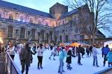
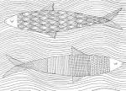



We Provided 2016/17
November 2016
Yr 11 Concert props £21.99
Yr 11 Prom / Year Book £100.00
The Hub Netflix Subscription £84.00
Cycle Container delivery £250.00
MFL Spelling Bee - £100.00
Young Carers colouring books £35.00
Young Carers Ice Skating £200.00
Graphic Novels Spinner for library £100.00 contribution
4 Tablets, cases and charger for use by Learning support £250.00+

Slide 9
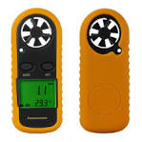

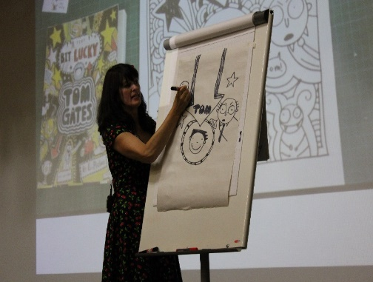
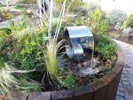
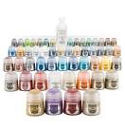
Where the money has gone…
2016/17
A tortoise and tortoise table £180
Paper cutting and Craft Club. £350
Bike Repair Club £200
Geography Department £414.48
Mosaic Club £ 90
Library £100
Textile Club £100
Modelling Club £110.54
Green Team £200

Slide 10
2017-2018
£10,035

Slide 11
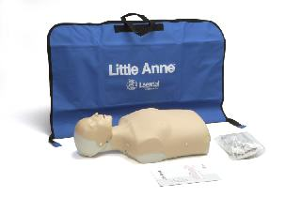
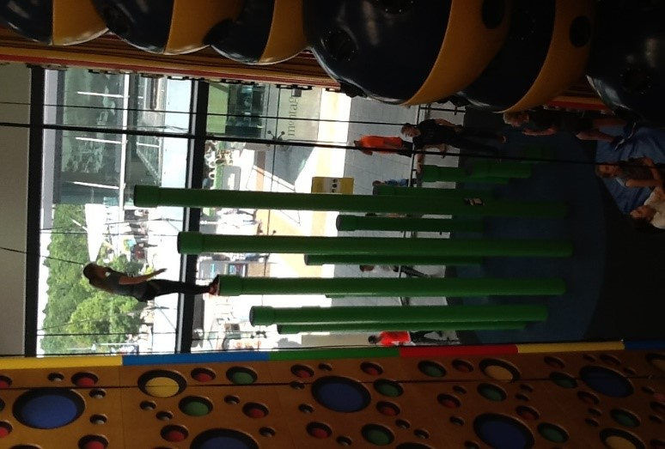
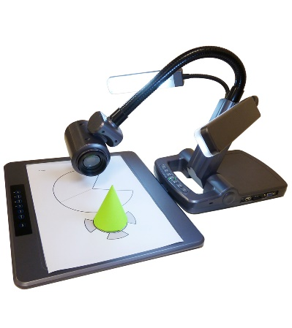
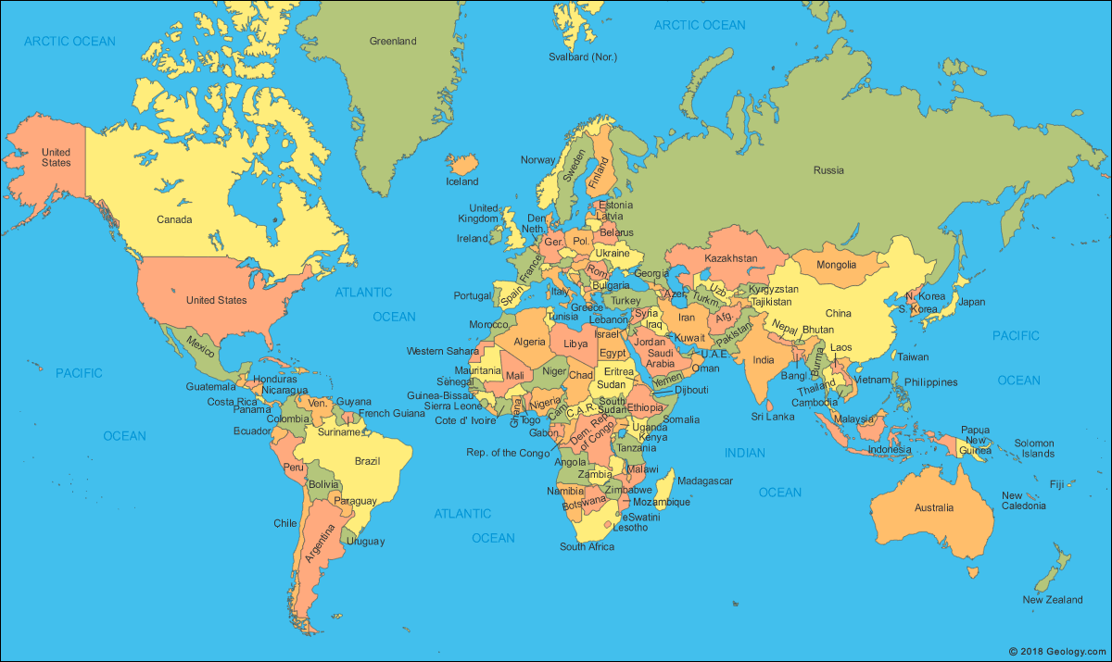

2017/18 How our PTA supports Thornden pupils
Thornden Young Carers £500
Simon Says at Thornden £500
Resuscitation Dummies £500
Visualisers for RE £160
History Block Wall Art £500
Duke of Edinburgh Kit £900
Warhammer Club £70
This Photo by Unknown Author is licensed under CC BY-NC-ND

Slide 12
How our PTA supports Thornden pupils 2017/18
  Software support for dyslexic students £1000
  Design and Technology Lego Robot competition £480
  MFL Plays, Spelling Bee and Oktoberfest £450
  Pastoral Support Resources £250
  Wessex Literary Festival programmes £80
  Hockey Goalkeeping Pads £360
  New Y7 ‘Challenge Tuesdays’ £100
  The Hub’s Netflix subscription £80
  Classroom library trial £50
  Women’s Group £100
  Thornden Live! Blog domain £80
  World Challenge £200 loan

Slide 13
2018-2019
£6400

Slide 14
Successful bids 2018-19 included
Nurture group resources including cash register. £100
Drama materials, hair accessories etc creating costumes for drama productions. £100
Lego club 4KG of lego to start.£60
Dungeons and Dragons club guides £56
Young Carers -70 students - £250
Science department -ducklings within school. £250
Dance groups t shirts £200
FOTS banner £70
Picnic benches £600.
• Food Tech- Storage trolley and woks. £500. • Pastoral care resources £500.
• Tempest production - £200
• Modern Foreign Languages- dry erase pockets £83.96
• School garden- seat cushions and parasol £150
• MFL Spelling Bee- Pizza rewards for the best spellers £150
• Young carers- funds for yoga sessions & snacks £300

Slide 15
2019-2020
£7695

Slide 16
19/20 successful bids included
English department - book corners in classroom £500
History department pupil prizes book vouchers £200
The Geography department Kaboodle £350
Author visits – library for years 7, 8 and 9 at a cost of approx. £500
Pastoral support - 4 workshops with every year 7 child. £250 granted
Maths Department resources £164.90
Lego club competition entry fee £150
Netflix subscription for hub £84
NATS - £175 STEM club glider kits.
Pastoral care £500
Young Carers £500 including trip to Longdown Dairy Farm.
Ducklings for Science week £260
Equipment for Food Tech classes - £212.32 Pasta rollers, pizza cutters and potato ricers.
Study skills for Escape activities - £60 Chests and padlocks for maths and English extra enrichment tasks
Study skills for toaster, supplies and help to put on a summer party for students on the study skills register. - £100
Study skills for window film for the Shed - £20
PE Dept for a cricket bowling machine - £500.

Slide 17
2019-2020 We were on course for a bumper year and then Covid struck – still we had already fitted in 2 meetings before lockdown!
PE rowing machines to use in a club and for general fitness £800
YEAR 7 TECHNOLOGY FAYRE die cutter £85.
FOREST SCHOOL - a range of tools £300
DRAMA Budget for the winter production based on Cornish folklore and mythology £300
Life Lab Peers promoting health within the school in the realms of emotional, mental and social well being. Aim to have around 60 trained students at any one time in the school to offer peer support and signposting. £1050
HOMEWORK/BREAKFAST CLUB glasses/mugs for this group. Previously purchased items have been passed on to Young Carers. Currently approximate 7% of the school are eligible for pupil premium. £50.
STEM CLUB
£160 to complement the £175 given to the school via a grant from NATS. This was to purchase The Power Gliders kit.

Slide 18
2020-2021
£9853

Slide 19
2020-21Successful bids included
(Reduced number of bids as pupils in school but still social distancing, no clubs running, bubbles, lots of time outside)
Forest school Outdoor learning £100
£400 for y7 courtyard improvements and wild flower meadow
£200 for shed 2.0
£8353 outdoor seating to include 21 benches and 8 picnic benches
Y11 leavers party ice cream van £300
Pastoral support £500

Slide 20
2021-2022
£21,427

Slide 21
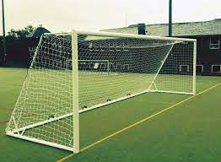

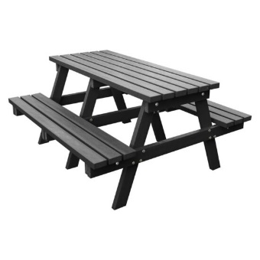

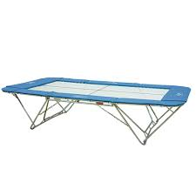

FOTS 2021/22
Picnic tables and benches £4800
Young carers, pastoral support etc. £2500
Astro goals. £979
Duke of Edinburgh tents, compasses, map holders £500
Dance/Drama camera for recording GCSE work £1000
Trampoline and mats £4005
PE school team kits £3730
Warhammer/Gaslands for Gaming Club £215
Alice in Wonderland set and costumes £ 400
Library display shelving £805
Chess Club £170
Ducklings £275

Slide 22
2022-2023
£22,095

Slide 23

FOTS 2022/23 giving
3D printers £5000
Young Carers, ELSA, Pastoral Support,
Forest School etc. £2700
Football goals, nets. £990
Duke of Edinburgh tents £945
Art cameras for recording GCSE work £507.63
Trampoline club leader £360
PE Sports Awards evening £500
Warhammer/Gaslands for Gaming Club £88.97
Bugsy! set and costumes £600
Library resources £415
Chess Club £110
Ducklings £290

Slide 24
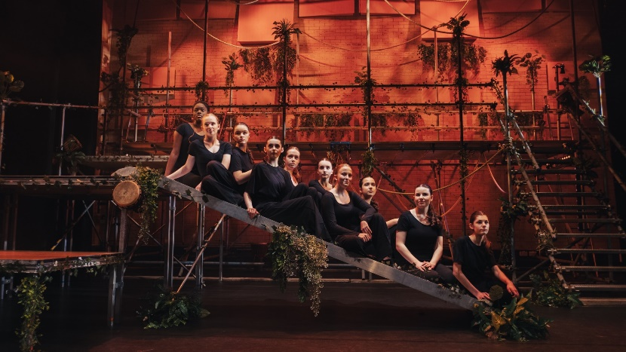
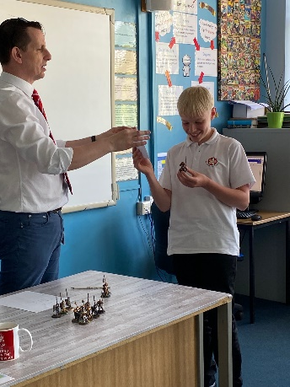
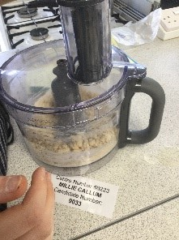
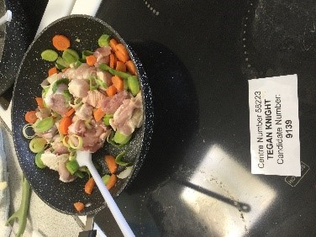
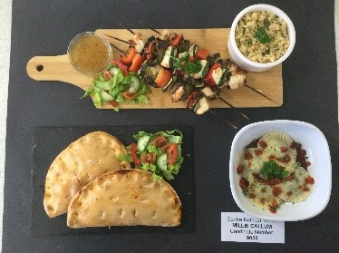
FOTS 2022/23 giving
Macbeth Theatre visit £1659
Jungle Book set/costumes £300
Maths awards £110
Break time footballs £80
Pokémon Club £100
Warhammer miniature painting prizes £100
Games for y7 tutor time £300
MFL play in each language £900
Furnishings for medical room £509
RS speakers on Holocaust and Rwandan Genocide £450
Food Tech display items, woks, food processors £1525

Slide 25
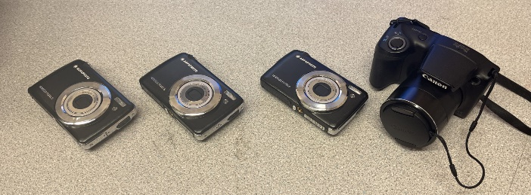
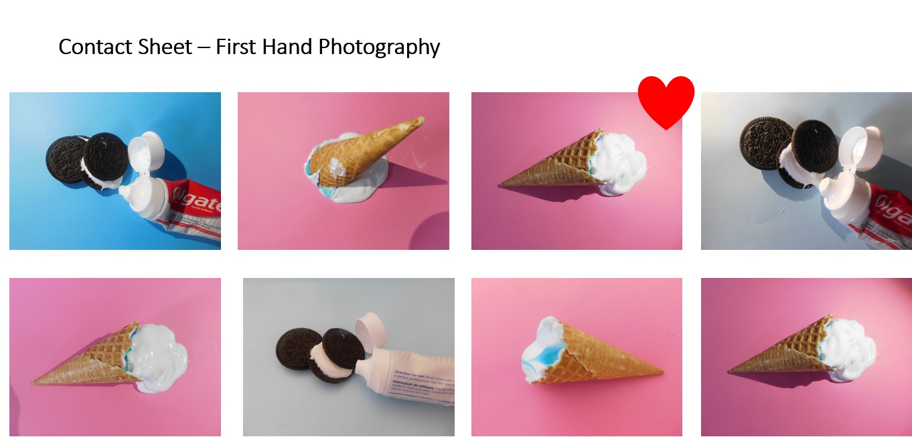
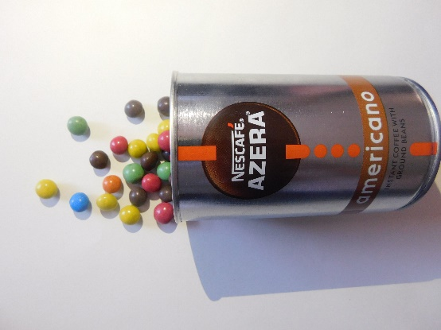
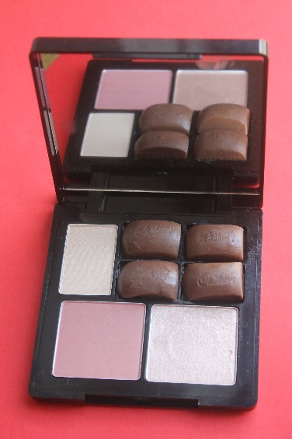

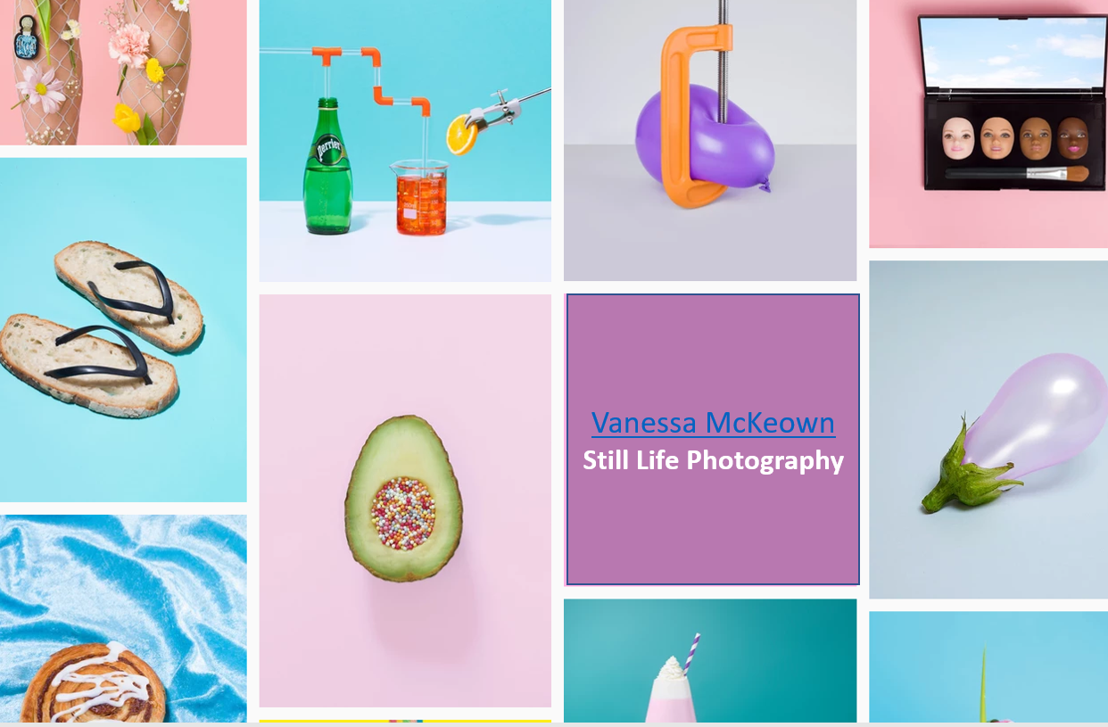
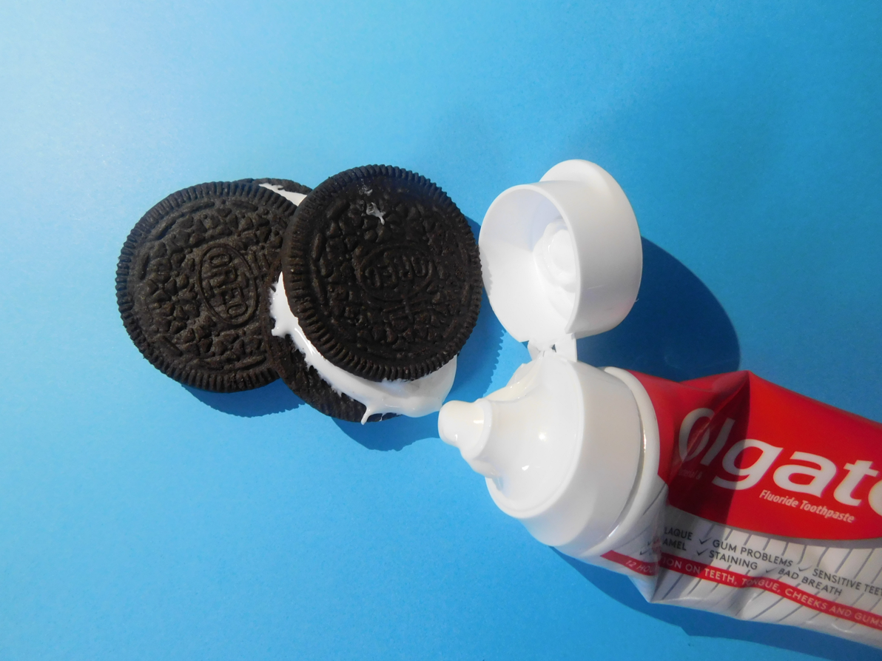
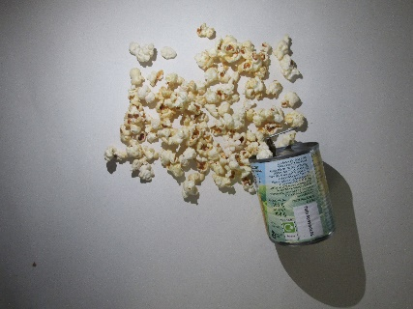
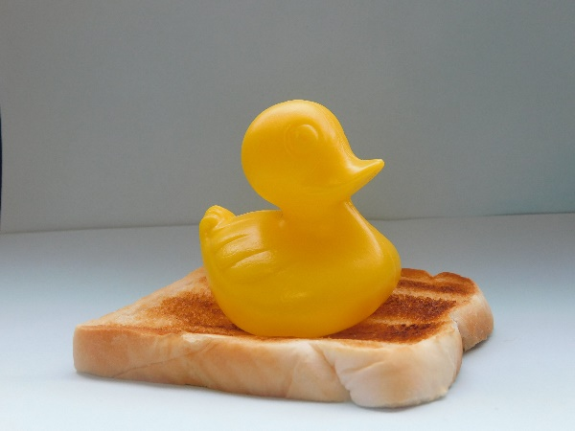
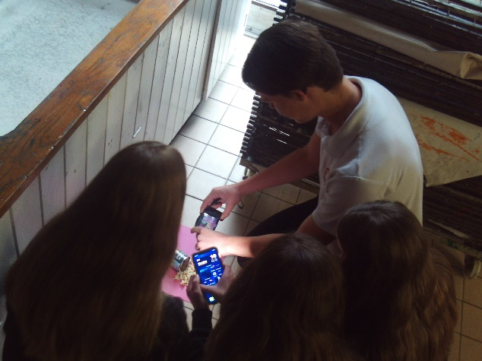
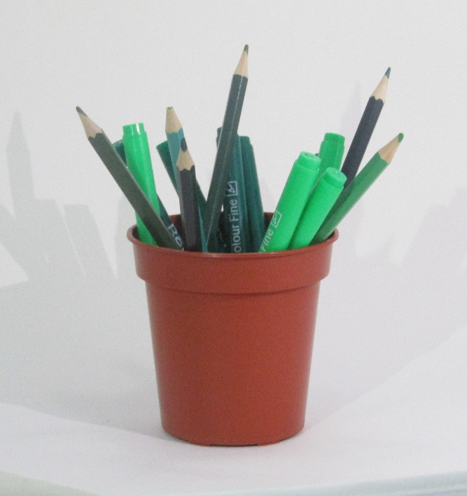
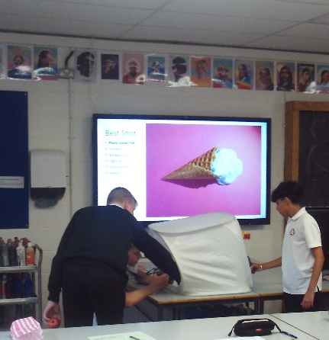
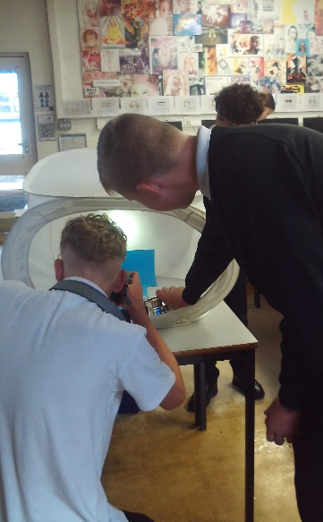
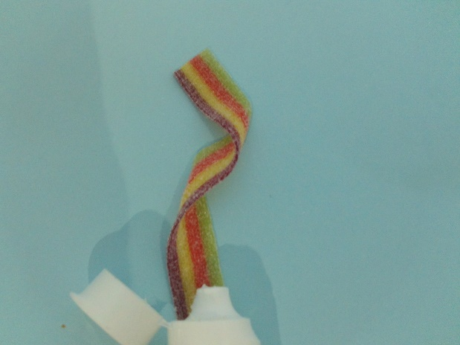
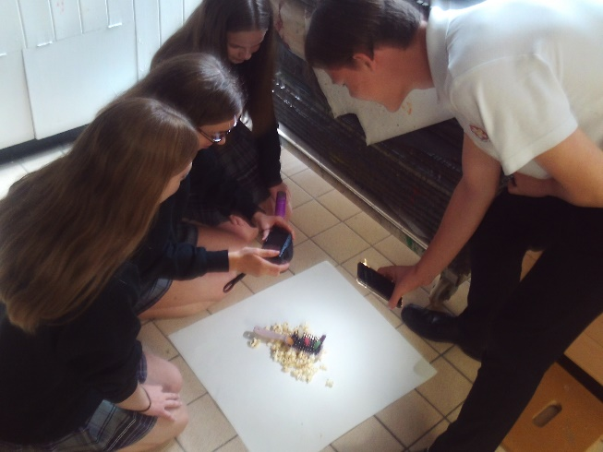
The new cameras from FOTS – Thank you!
The inspiration – Vanessa McKeown H/L - bring a prop
The outcomes…
The learning…
Next…editing in photoshop

Slide 26
2023-2024
£5874 so far

Slide 27
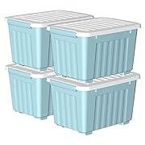
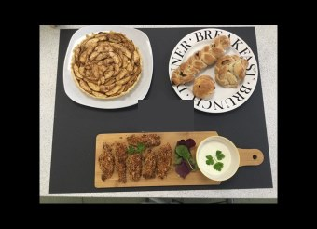
i.English fast feedback machine – requested 16 machines, agreed to trial use of 4 machines. - £240.
ii.Modern Foreign Languages plays –£300
iii.Pastoral Support – furnishing new, larger wellbeing den. £350.
iv.Pastoral Support: Young Carers – £500
v.ELSA funding – Wates donation allocated to ELSA support. £500
vi.Food Tech – replace aprons. £300
vii.Food Tech – replace chopping boards. £400
viii.FOTS – to purchase storage boxes and light for FOTS shed. £50

Slide 28
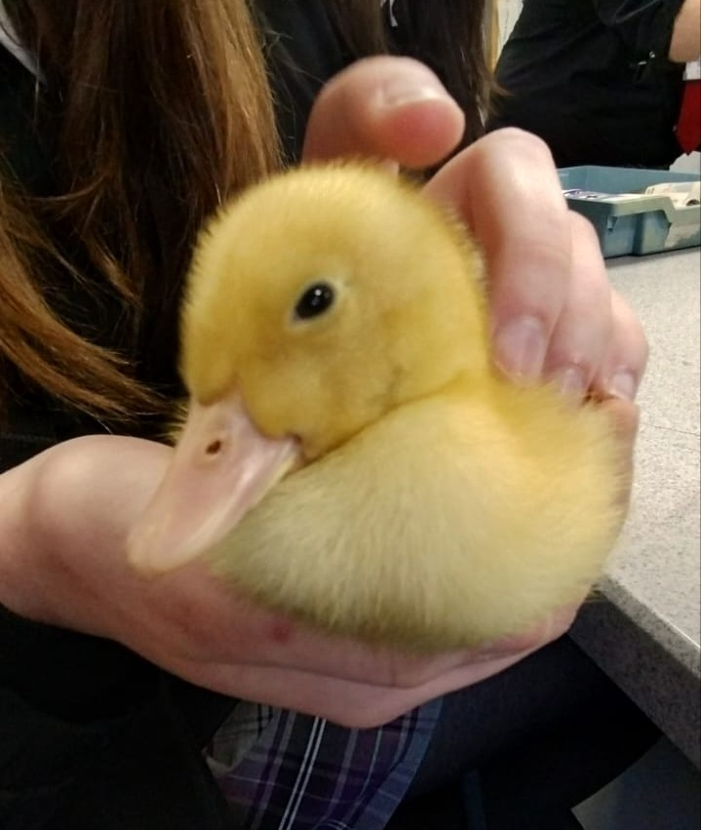

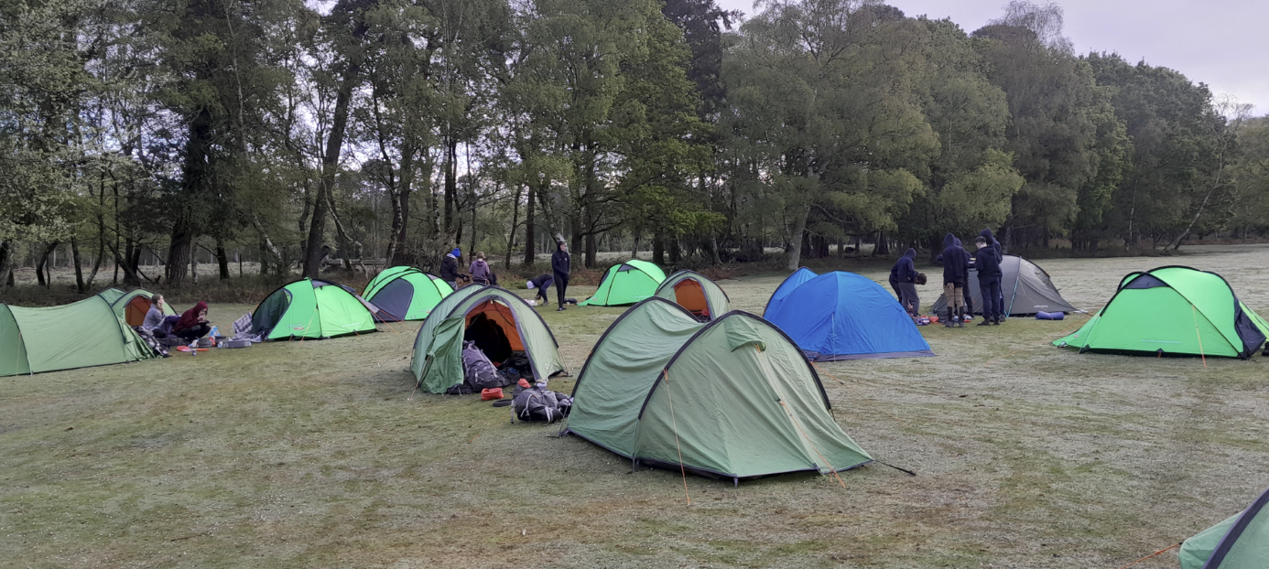
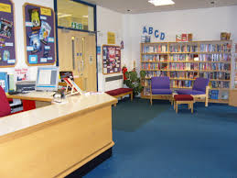
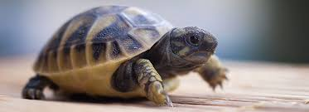
Annie production costs - £400
Boys dance workshop and performance event - £500
DofE tents and sleeping mats £405
Geography sets of white boards £164.34
Bereavement group - £150
£300 - Y9 belong event
£200 - Y8 belong event
Y7 belong event - £ 300
World book day dressing up prizes £150
Medical room - £65 – tights and sundries
Science department tortoise and ducklings - £500
£100 – class set of litter pickers

Slide 29
Please sign up to the gift aid donation scheme to help fots continue to help Thornden Students
Thank you for your support!

